Slide 1
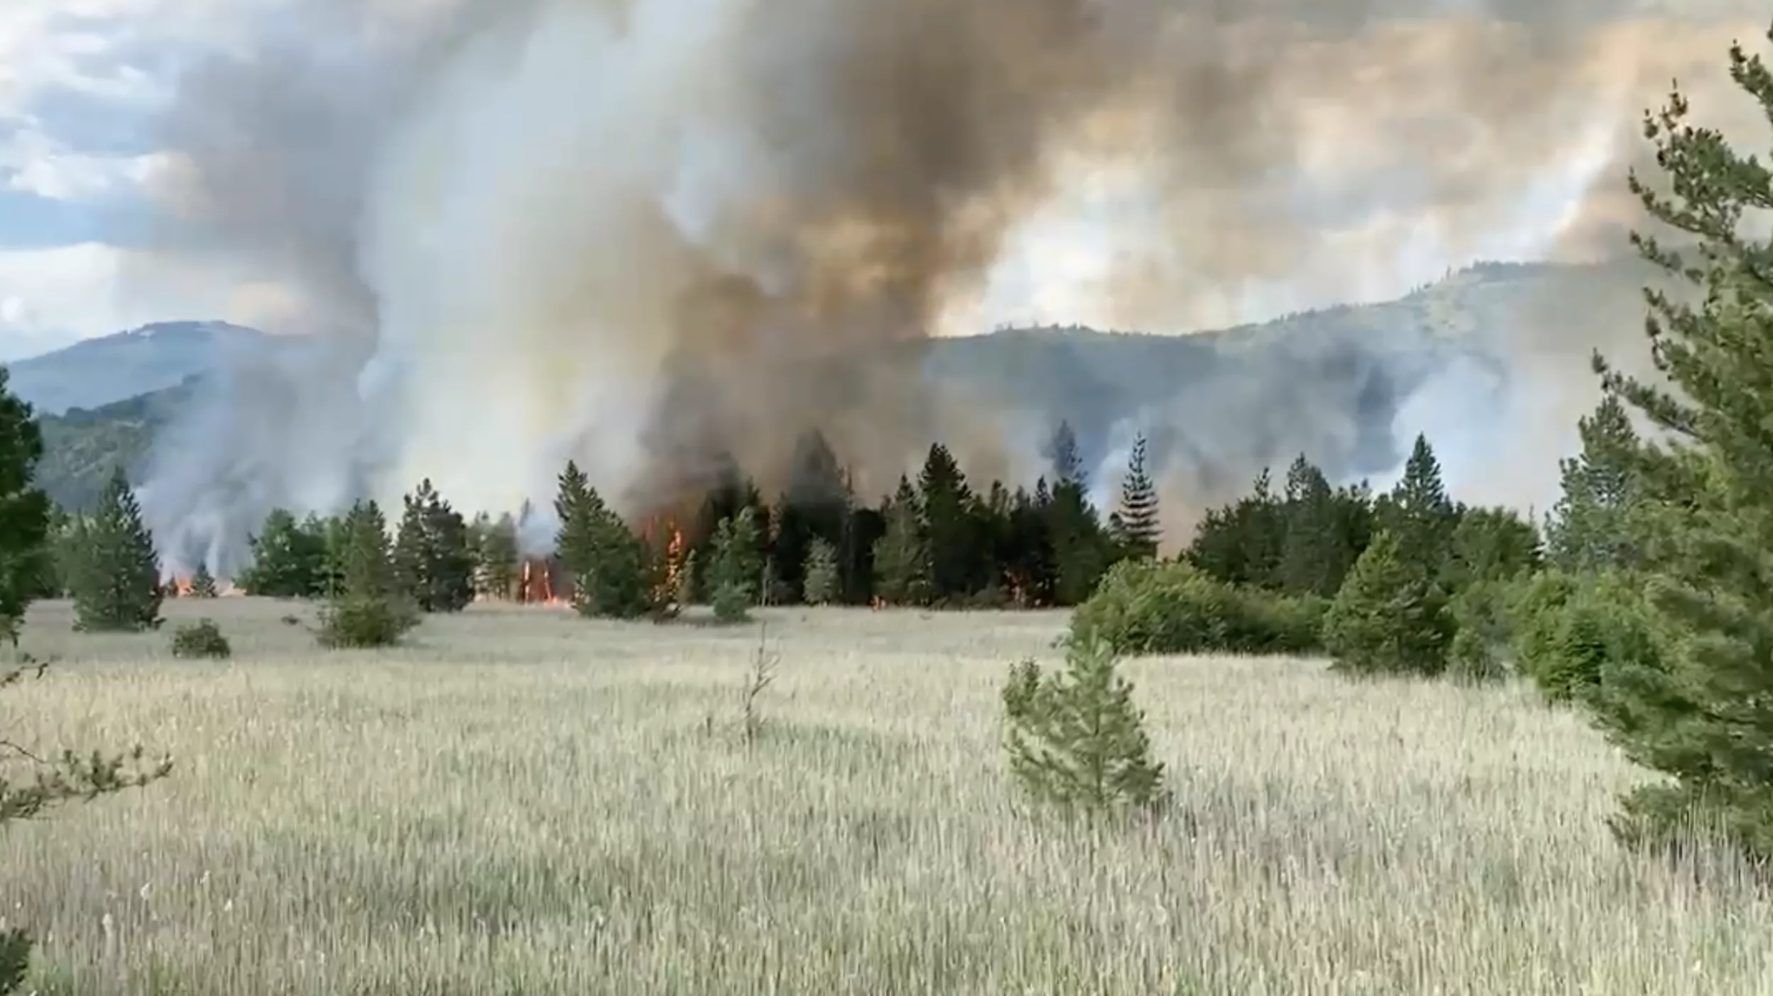
Measuring Differences between Rank Variable Wildfire Risk and Burned-Unburned Area Mask: A Case Study from Idaho
GEOG 279/ 379
Brenner Burkholder, Max Lutz, Rahebe Abedi,
Ravi Thapaliya, Mina Wei and Vishal Muda
Photo credit: https://www.spokesman.com/stories/2021/jul/07/20-acre-fire-burning-near-cataldo-mission-wednesda/

Slide 2
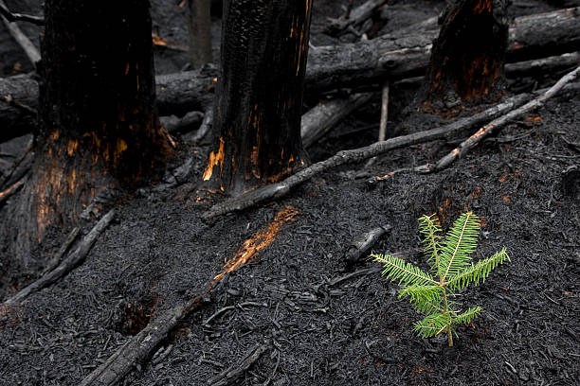
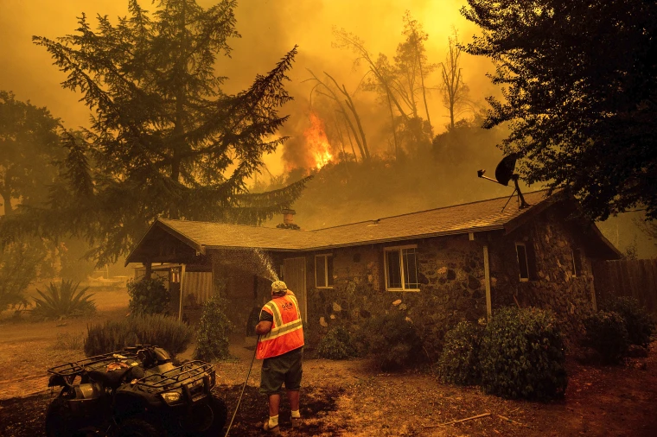
Wildfire Background
Photo Credit:https://www.istockphoto.com/photos/new-growth-after-forest-fire
Wildfires are a naturally occurring phenomena
Healthy for forest ecosystems
Not so healthy for human systems
Wildfires contribute to Climate Change
Literature expects an increase in the total burned area given Climate Change (IPCC, 2007; Balshi et al., 2009; Bowman et al., 2009; Spracklen et al., 2009).
Photo Credit: https://www.nbcnews.com/news/us-news/california-neighbors-hoses-target-wildfires-crews-urge-them-stop-n1238637
Notes:
Wildfires are a natural occurrence that can be nearly impossible to stop and challenging to control.
Frequent forest wildfires have devastated the planet: releasing years of carbon stored in the land, and causing a significant loss of carbon absorption capacity in future trees, forest soil erosion, and increased air pollution from toxic particulates.
Our project is to help prevent wildfires by simulating a map of how they occur. This focus on the Idaho region.
Most climate change models predict an increase in burned area across North America (IPCC, 2007, Balshi et al., 2009, Bowman et al., 2009, Spracklen et al., 2009).

Slide 3
Objective of this study
We set out to create wildfires susceptibility maps of the state of Idaho using a deductive model method using static and non-static variables.
We examined our model outputs using the total operating characteristic for modeled ranked maps vs 2021 Wildfires.
ESRI Story map as a final product
Emphasis on TOC curve application for analysis
Post to wikipedia as an example of TOC curve utilization
Notes:
To develop an ArcGIS Online Story Map in order to compare the actual burned area in the state of Idaho with the modeled wildfire risk
To compare the modeled categorical wildfire risk and actual burned areas for a few selected years in the state of Idaho with the help of the Story Map
To include a TOC Curve and contingency table of ranked risk versus a real burned-unburned binary for each model
To discuss the benefits of utilizing TOC curves for this kind of analysis as opposed to other approaches like ROC
Improve model performance with indices such as Normalized Difference Vegetation Index (NDVI), Evaporative Demand Drought Index (EDDI) and Evaporative Stress Index (ESI) indicators

Slide 4
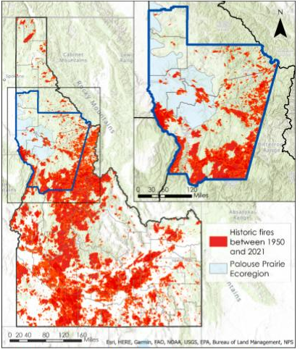
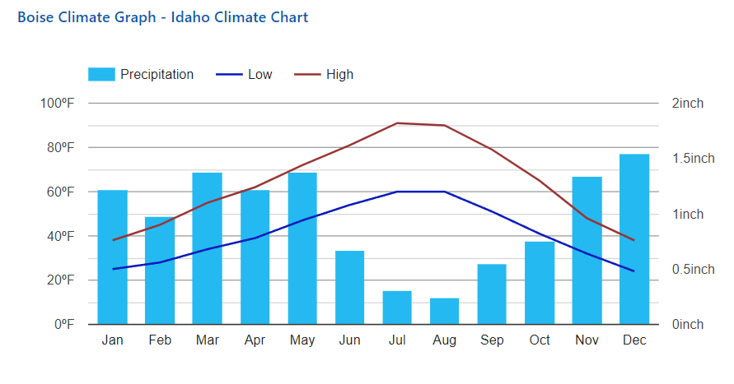
Study Area
This study is looking at the state of Idaho.
The central and northern regions are mountainous and forested
Southern region of Idaho is predominantly scrubland and agriculture
Idaho is prone to wildfires
Idaho state with historical fires between the years 1950 and 2021 shown in red. Blue outline is DEVELOP study area, black is Idaho / our group’s study area (NASA DEVELOP ID Wildfires Summer 2022)
Source: https://www.usclimatedata.com/climate/idaho/united-states/3182
Notes:
The study area is Idaho boundary.
Idaho's precipitation is concentrated in the winter and summer, and the climate is dry. Mountains are predominant and forests are abundant. The southern rectangular area is predominantly scrub and agricultural land

Slide 5
Deductive Model Flow
Historic Fire Density
Static Inputs
Non-static Input
Vegetation Type
Operators
Model Output
Wildland Urban Interface
Slope
Sum Values in Raster Calculator
Project Raster
Wildfire Hazard Map
Aspect
NDVI Dif. or ESI

Slide 6
Deductive Model Flow
Static Inputs
Non-static Input
Operators
Historic Fire Density
(Values 0 to 3)
Model Output
Vegetation Type
(Values 0 to 6)
ESI
(Values 0 to 4)
Sum Values in Raster Calculator
ESI Model
Wildland Urban Interface
(Values 0 to 2)
Sum Values in Raster Calculator
Base Model
Sum Values in Raster Calculator
NDVI Difference Model
Slope
(Values 1 to 3)
NDVI Seasonal Difference
(Values -4 to 4)
Aspect
(Values 0 to 3)

Slide 7
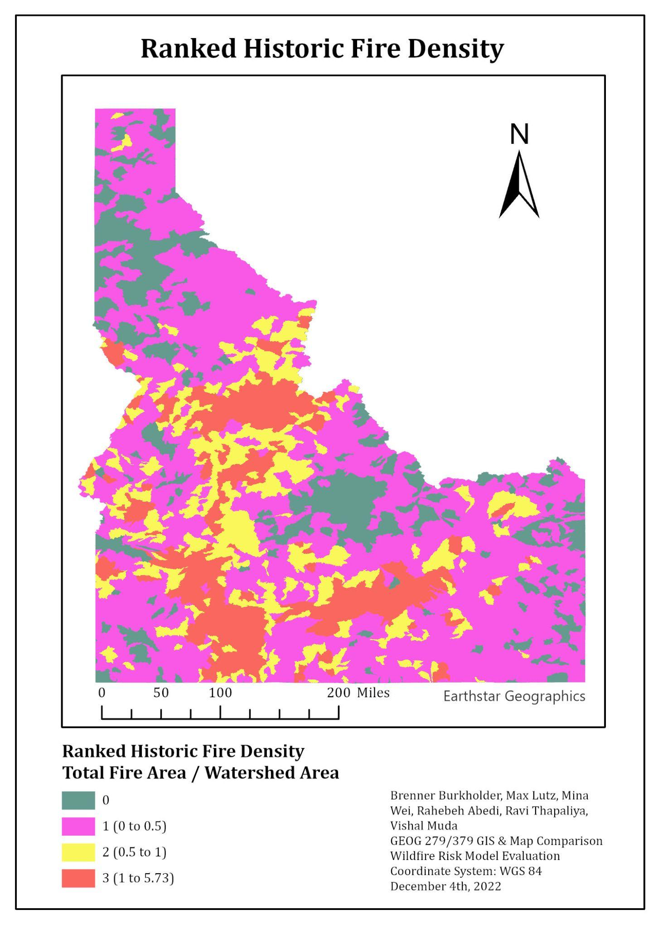
Historic Fire Density
Historic fires from 1950 to 2020
Total fire area within the watershed divided by the total area of the watershed
Fire densities are greater than 1 due to the burn areas being summed over a 70 year time period

Slide 8
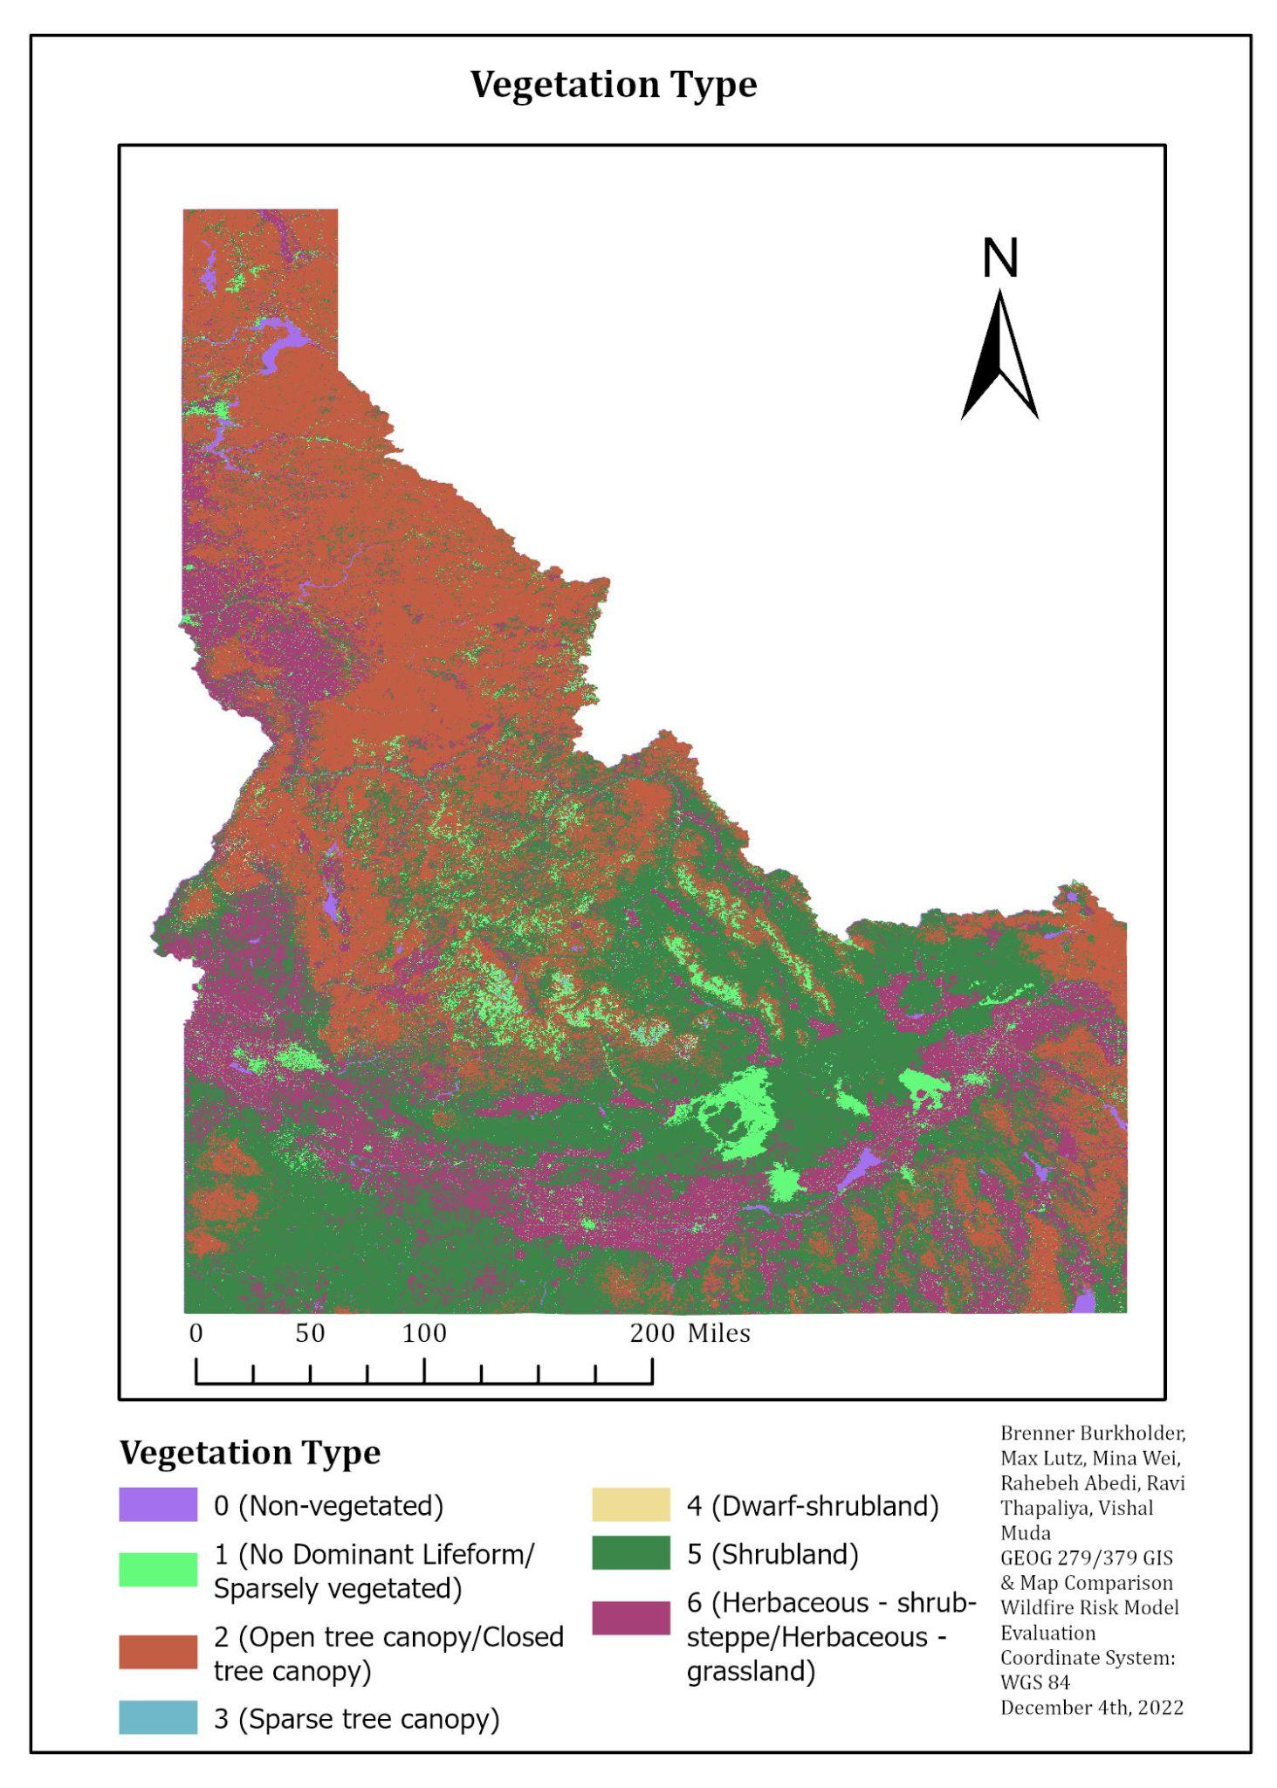
Vegetation Type
Vegetation was reclassified into 7 classes
Finer fuels are easier to ignite
Ranked giving the finer fuels higher weight
Assuming non-vegetated land cannot burn

Slide 9
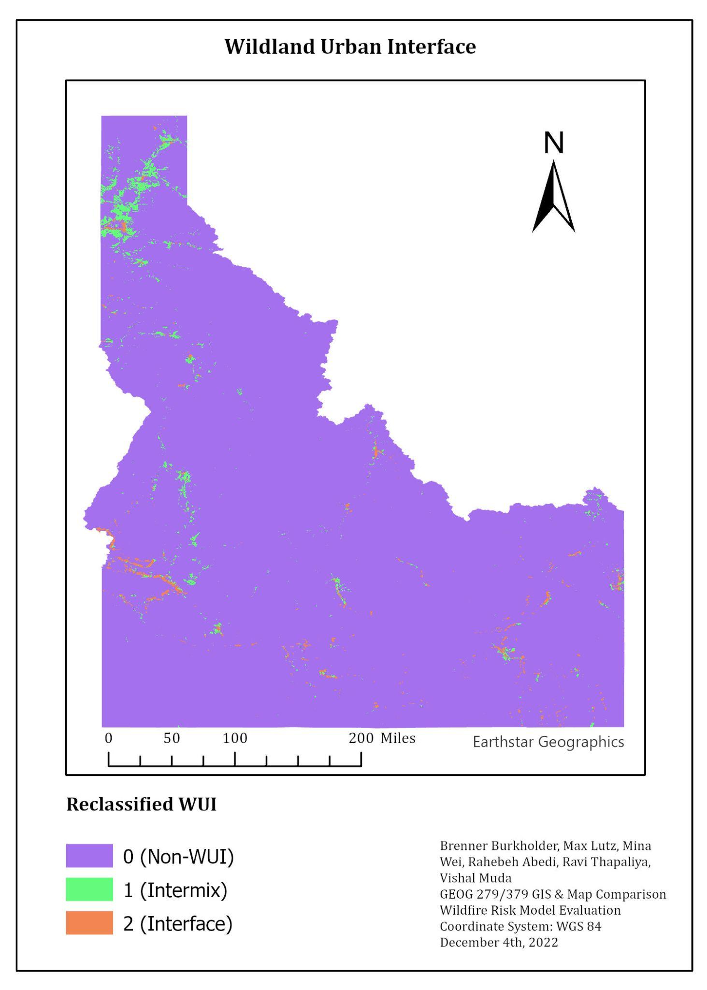
Wildland Urban Interface
Intermix WUI
Urban and vegetation intermingle
Urban density of >1 per 40 acres
Greater than 50% of area in wildland vegetation
Interface WUI
<50% vegetation but within 1.5 miles of densely vegetated area
Notes:
Intermix WUI (reclassed to 1) is where houses and wildland vegetation intermingle, with both a housing density of >1 house per 40 acres (6.17 houses/km2 ) and >50% of the area in wildland vegetation.
Interface WUI (reclassed as 2) represents settled areas that have <50% vegetation, but lie within 1.5 miles (2.4 km) of a densely vegetated area (at least 75% wildland vegetation) that is at least 5 km2 in size

Slide 10
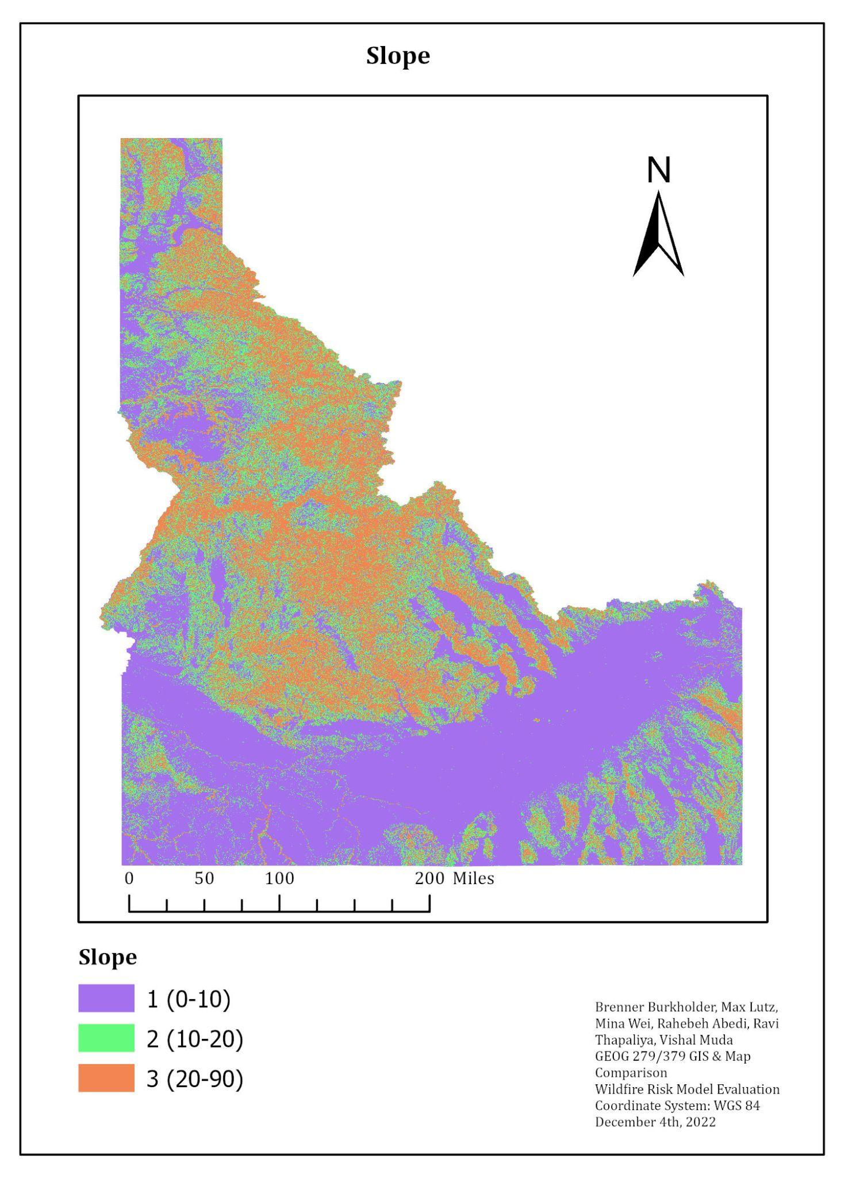
Slope
Fire can spread faster and ignite more land given a higher slope
Slope was classified assigning higher slopes higher rank
Notes:
the fire can spread faster and ignite more land given a higher slope and the slope was classified assigning higher spoles higher rank. The orange area is the mountain region

Slide 11
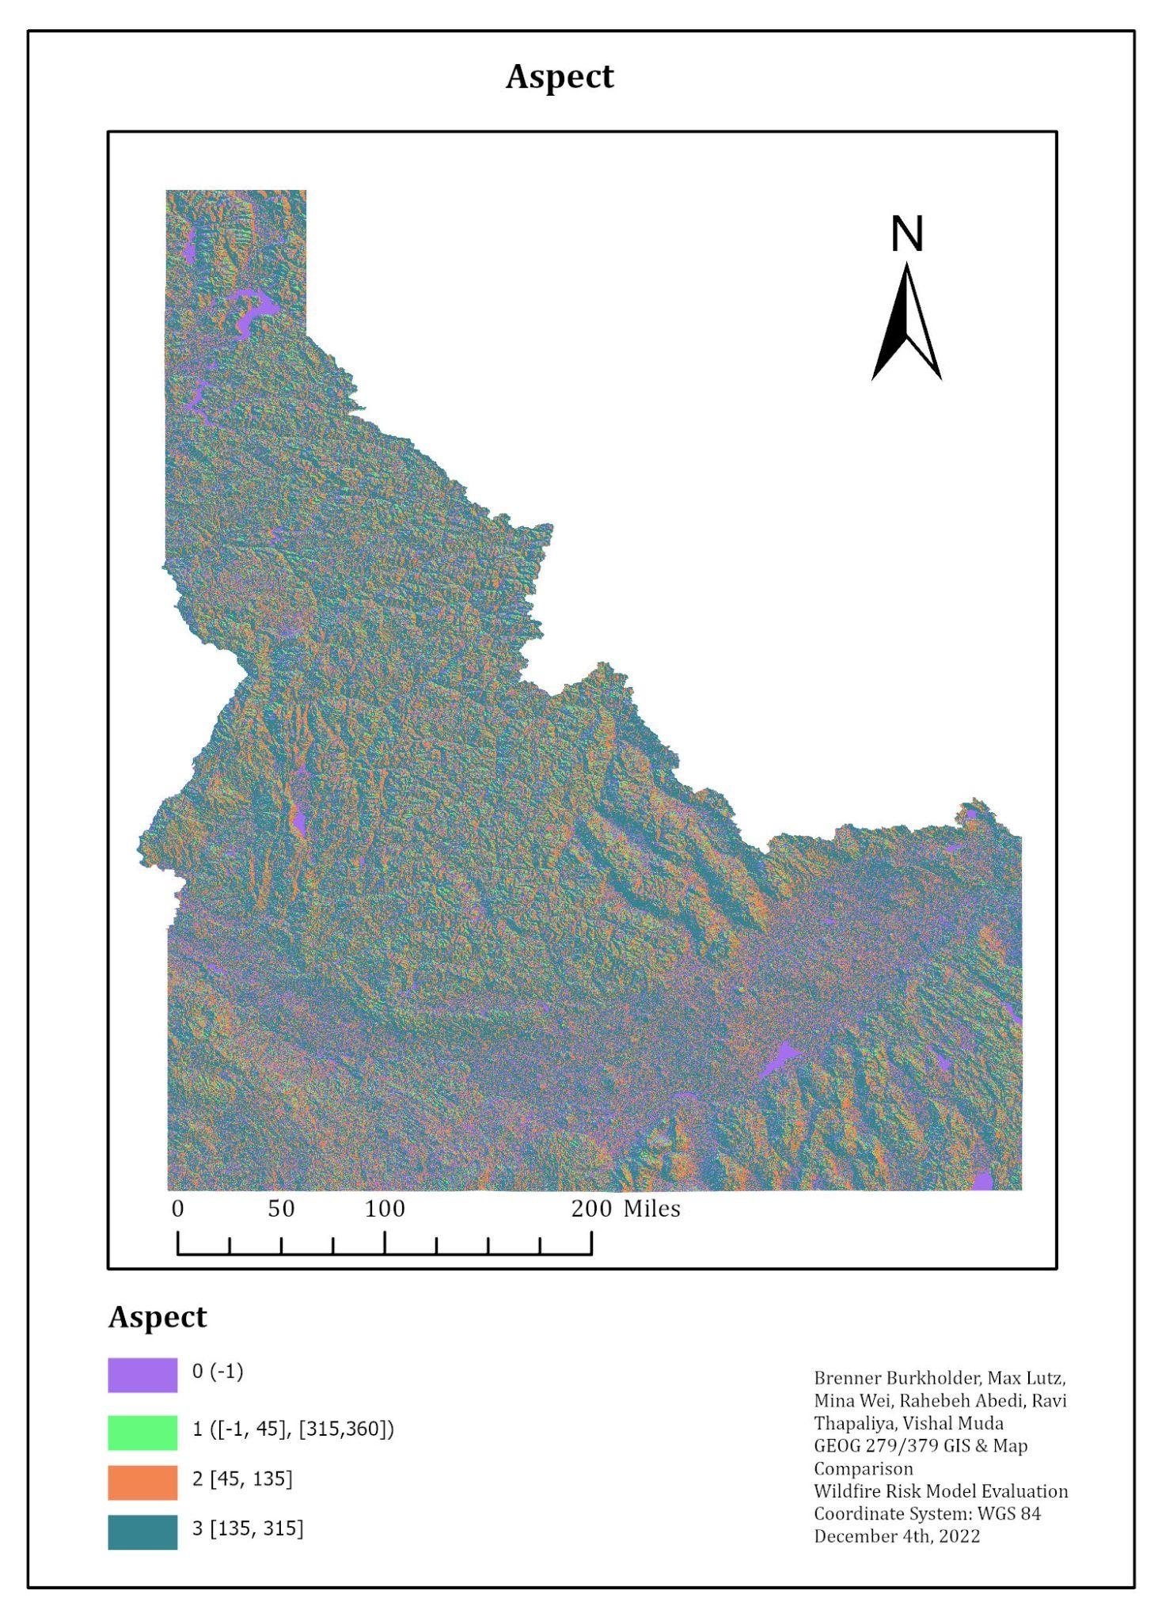
Aspect Class
Southern aspects get more sun than northern aspects
Leading to drier conditions
Western aspects get dry wind from mountainous region due to predominant westerly winds
Ranking
0 = Flat
1 = North
2 = East
3 = South & West
Notes:
The south receives more sunlight so the land is more likely to dry out, There are dry winds from the mountains in the west, so it is also drier. We can see that on the blue(3)on the map

Slide 12
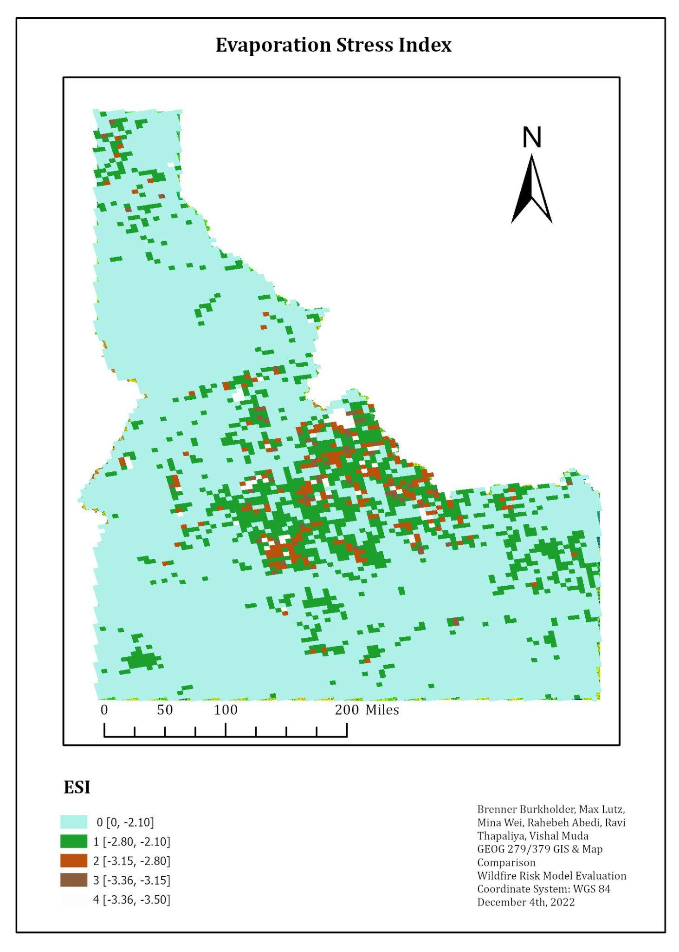
Evaporative Stress Index
This index estimates the water that is lost from Evapotranspiration (ET)
ESI shows areas of drought where vegetation is in stress condition because of the deficiency of water
Useful for drought monitoring

Slide 13
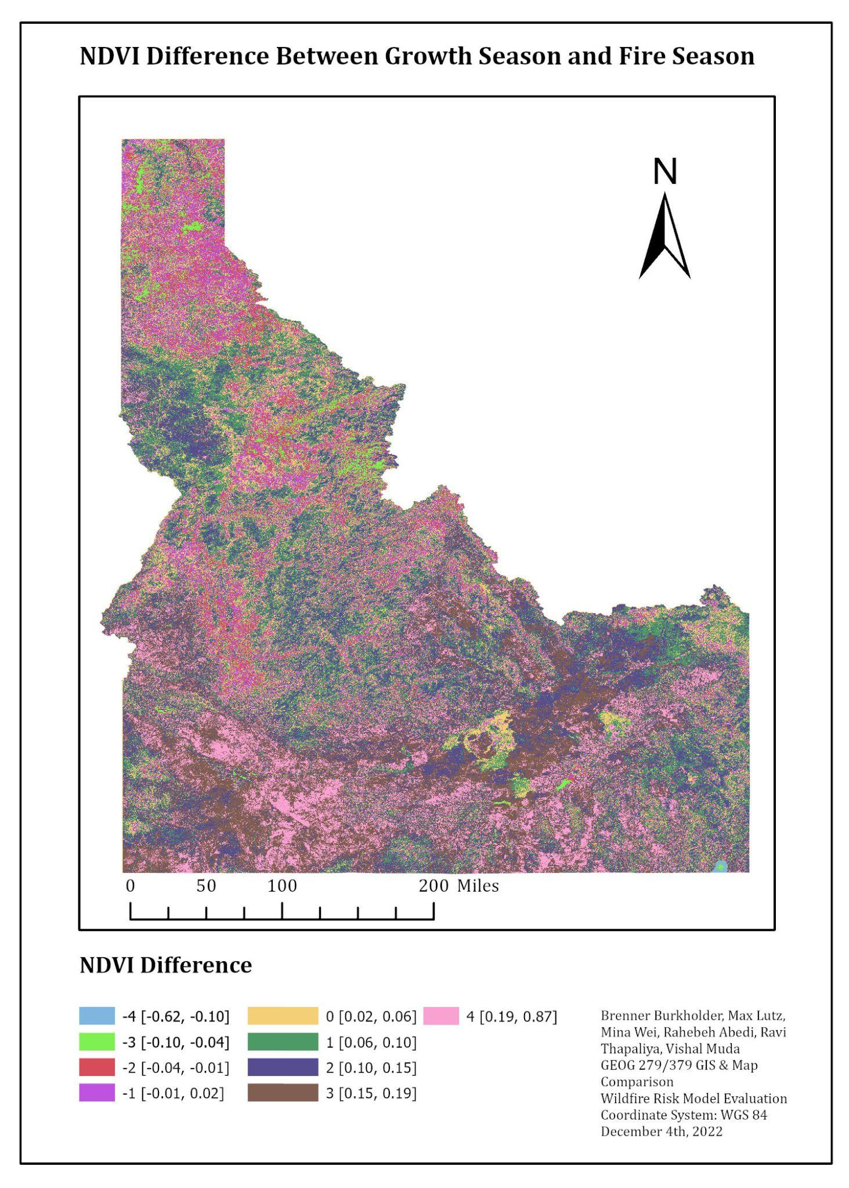
NDVI Seasonal Difference
Growing Season NDVI - Fire Season NDVI
Growing Season is March through May
Fire Season is June through September
Use of negative values due to reduced risk given growth in fire season
Consistent with U.S Drought Monitor classification percentile scheme: Exceptional Wetness, Extreme Wetness . . .

Slide 14
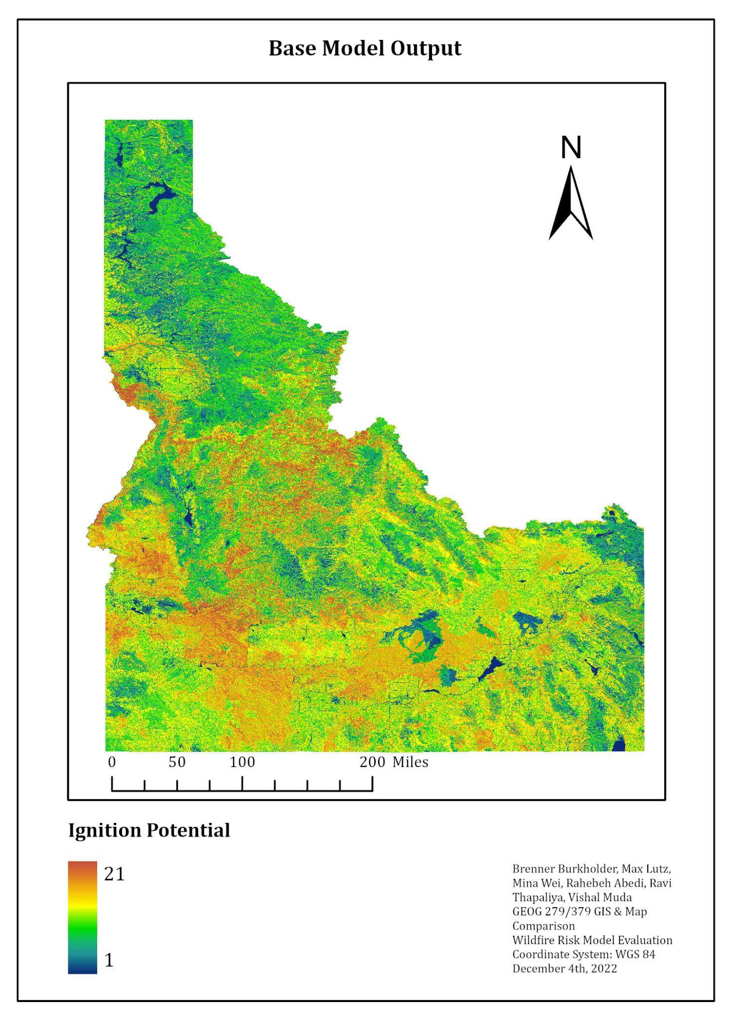
Base Deductive Model Output
Summation
Historic Fire Density
Vegetation Type
Wildland Urban Interface
Slope
Aspect

Slide 15
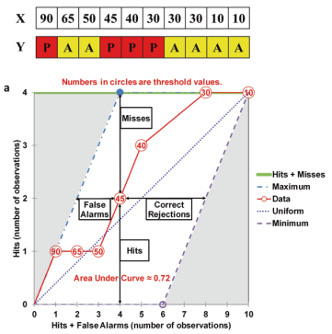
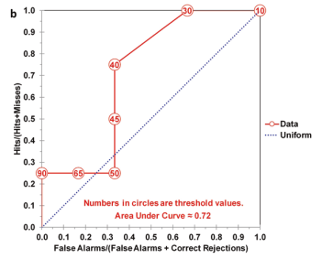
Total Operating Characteristic (TOC) Curve
https://lazygis.github.io/projects/TOCCurveGenerator
Metrics that Make a Difference

Slide 16
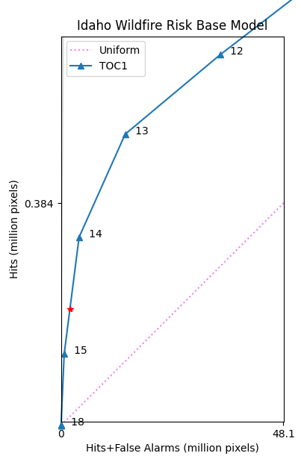
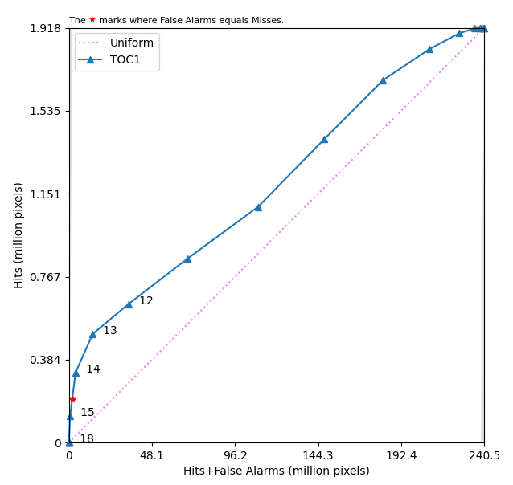
Base Model TOC

Slide 17
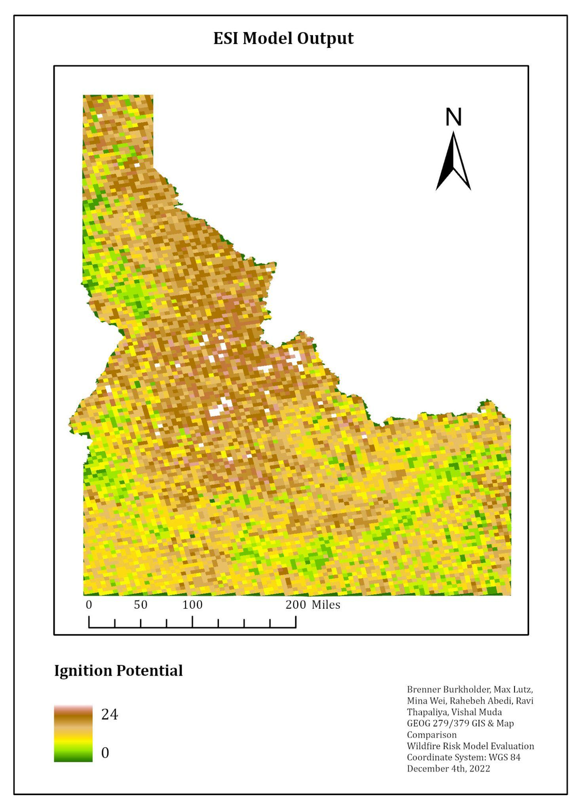
Evaporative Stress Index Model Output
Summation
Historic Fire Density
Vegetation Type
Wildland Urban Interface
Slope
Aspect
ESI

Slide 18
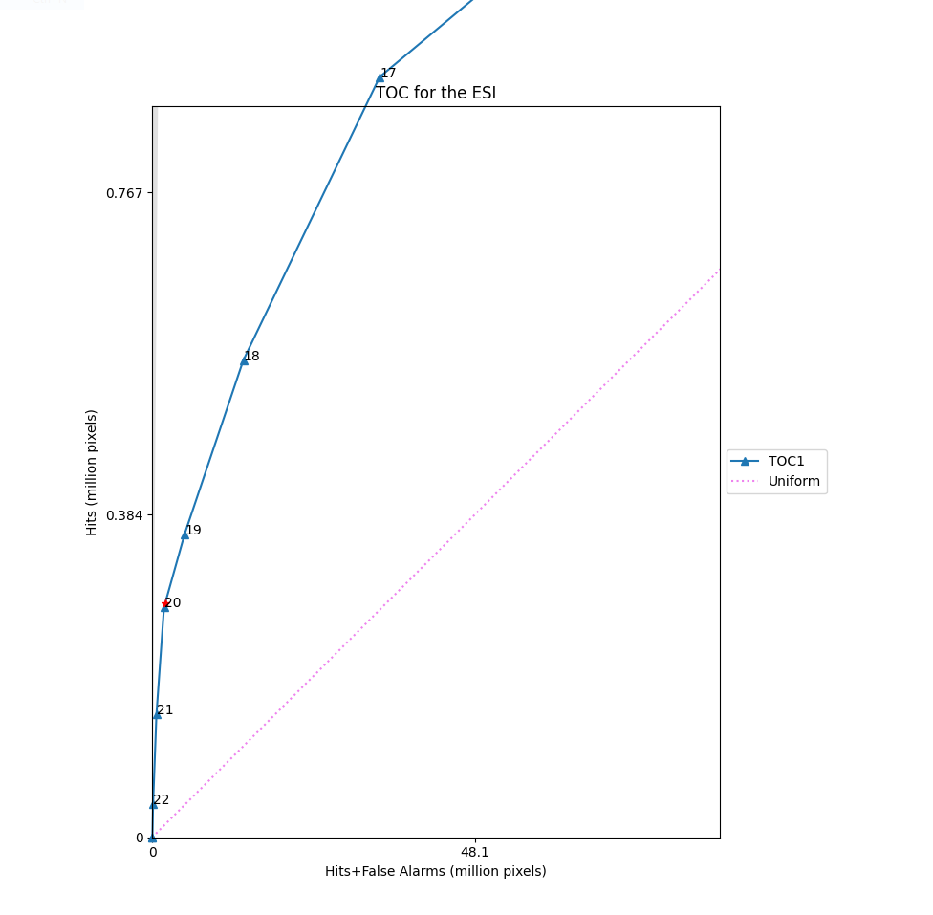
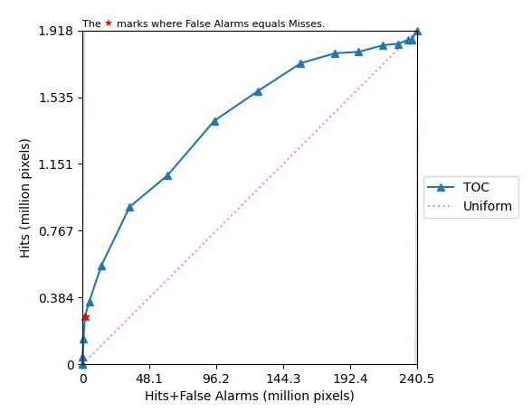
ESI TOC
Notes:
Hit intensity increased from base model. 20 is great threshold, because it is near the star indicating an equal number of false alarms and misses- the point where misses are due to allocation

Slide 19
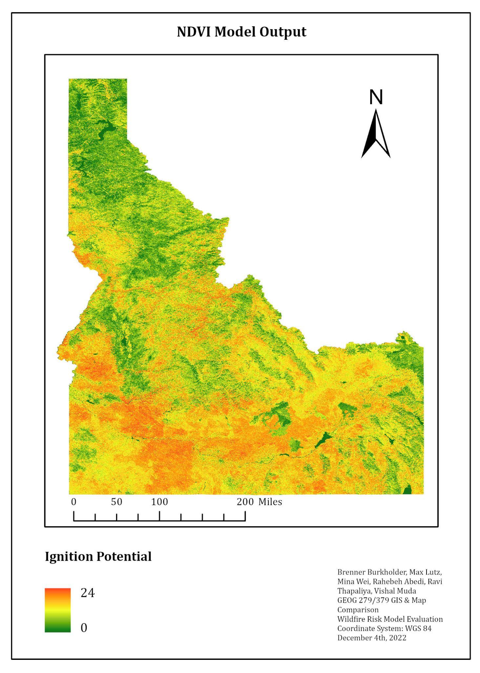
Seasonal NDVI Difference Model Output
Summation
Historic Fire Density
Vegetation Type
Wildland Urban Interface
Slope
Aspect
Seasonal NDVI Difference

Slide 20
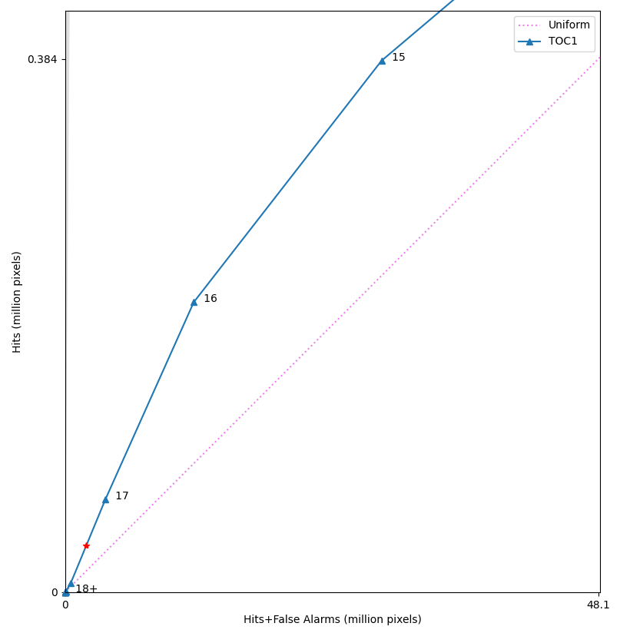
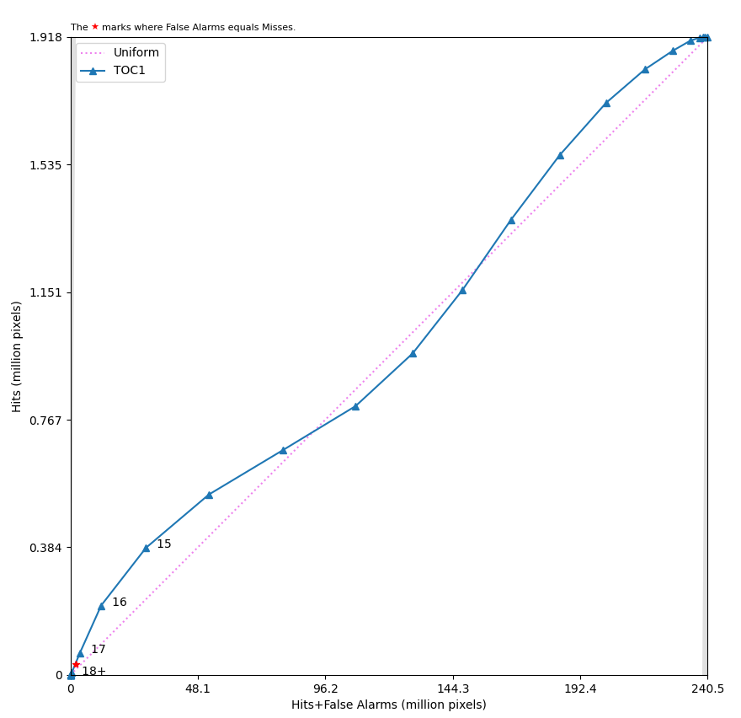
NDVI TOC

Slide 21
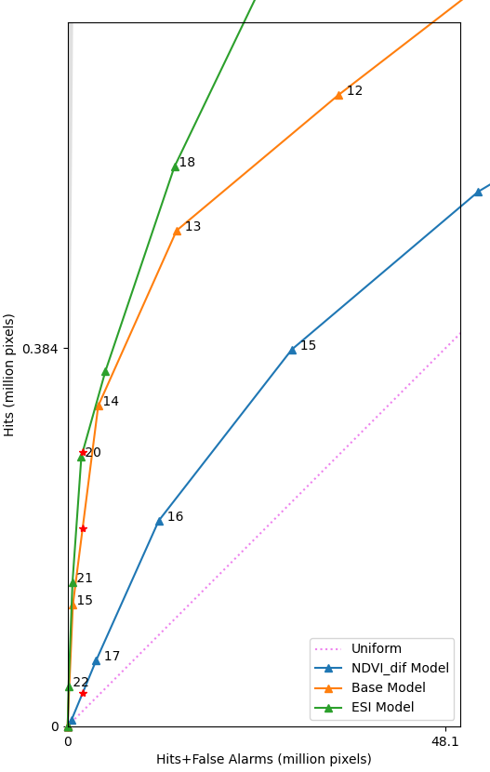
Multi-TOC Comparison
ESI has the steepest curve and strongest hit intensity for high-risk thresholds

Slide 23
Discussion of Analytical Issues
Limitations of TOC Curve Generator: It is difficult to label and examine thresholds near the origin.
Our highest risk thresholds may have strong hit intensity, but have very few pixels in their classes- see tables in slides 13 and 15.
For grouping thresholds into general risk categories, it would be good practice to examine pixel counts alongside the TOC curves.
Limitations of a deductive model: We assume we fully understand the behavior of our model drivers, but they behaved differently than expected. For example, the NDVI difference model performed worse than we expected, but growing season and fire season are almost certainly different for montane versus rangeland ecosystems.

Slide 24
Conclusions
The ESI model improved the base model, with increased hit intensity of high-risk thresholds in the ESI model versus the base model. ESI’s false alarms = misses star is closer to the upper left bound of the TOC area than the base model’s, indicating less allocation error.
The NDVI seasonal difference reduced base model performance, with lower hit intensity of high-risk thresholds compared to the base model. NDVI seasonal difference’s false alarms = misses point is further from the upper left bound of the TOC area than Base or ESI’s, indicating more allocation error than the base model.

Slide 25
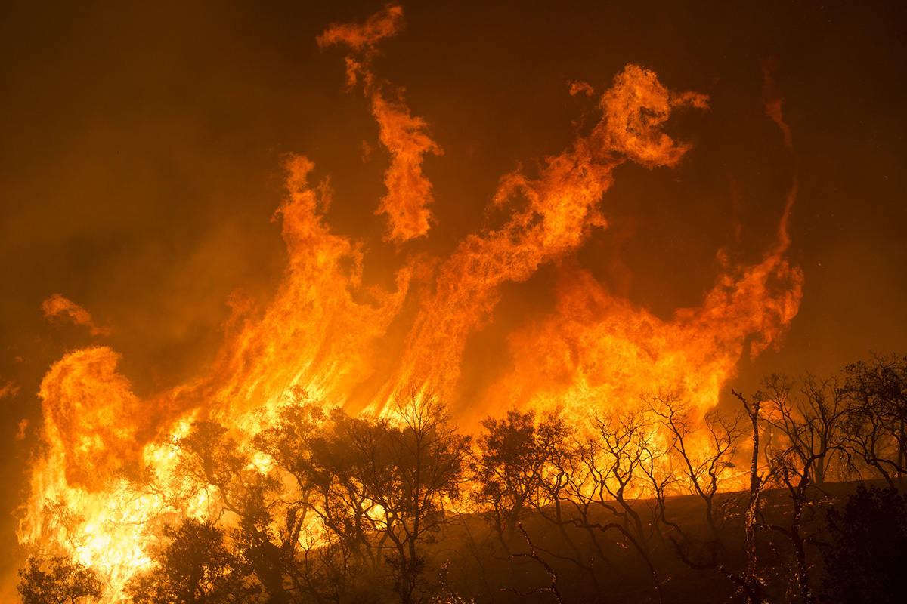
Thank you for your attention!

Slide 26
Data Sources
Source | Data Product | Dates | Acquisition Method
NOAA – PSL | Evaporative Demand Drought Index (EDDI): 4-week Daily CONUS 13km | 2013–2021 | Scripted download from NOAA data archive
NASA RECOVER | NASA RECOVER value added National Elevation Dataset | 2016 | NASA SRTM Digital Elevation 30m From GEE
NASA MSFC/SPoRT | Evaporative Stress Index (ESI): 4-week Daily Global 5km | 2013–2021 | SERVIR ClimateSERV Application

Slide 27
Data Sources (continued)
Source | Data Product | Dates | Acquisition Method
Keith Weber, Idaho State University GIS Training and Research Center | Historical Fires Database | 1950–2021 | From Keith Weber, ISU
Silvis Lab, UW-Madison | Wildland Urban Interface (WUI) | 2022 | WUI Change Portal
LANDFIRE, Earth Resources Observation and Science Center | LANDFIRE Existing Vegetation Type | 2020 | LANDFIRE Portal
USGS and USDA | National Watershed Boundary Dataset 12-digit hydrologic unit (HU) | 2022 | ArcGIS Portal

Slide 28
Selected References
Balshi, M. S., McGUIRE, A. D., Duffy, P., Flannigan, M., Walsh, J., & Melillo, J. (2009). Assessing the response of area burned to changing climate in western boreal North America using a Multivariate Adaptive Regression Splines (MARS) approach. Global Change Biology, 15(3), 578-600.
Burkholder, B., Freyberg, F., Hiatt, J., & Schuetze, C. (2022). NASA DEVELOP Idaho Wildfire Project. DEVELOP Idaho Node, Summer 2022.
Bowman, D. M., Balch, J. K., Artaxo, P., Bond, W. J., Carlson, J. M., Cochrane, M. A., ... & Pyne, S. J. (2009). Fire in the Earth system. science, 324(5926), 481-484.
Kolden, C. A., Lutz, J. A., Key, C. H., Kane, J. T., & van Wagtendonk, J. W. (2012). Mapped versus actual burned area within wildfire perimeters: characterizing the unburned. Forest Ecology and Management, 286, 38-47.
Pontius, R. G. (2022). Metrics that make a difference: How to analyze change and error. Springer.
Spracklen, D. V., Mickley, L. J., Logan, J. A., Hudman, R. C., Yevich, R., Flannigan, M. D., & Westerling, A. L. (2009). Impacts of climate change from 2000 to 2050 on wildfire activity and carbonaceous aerosol concentrations in the western United States. Journal of Geophysical Research: Atmospheres, 114(D20).

